Slide 1
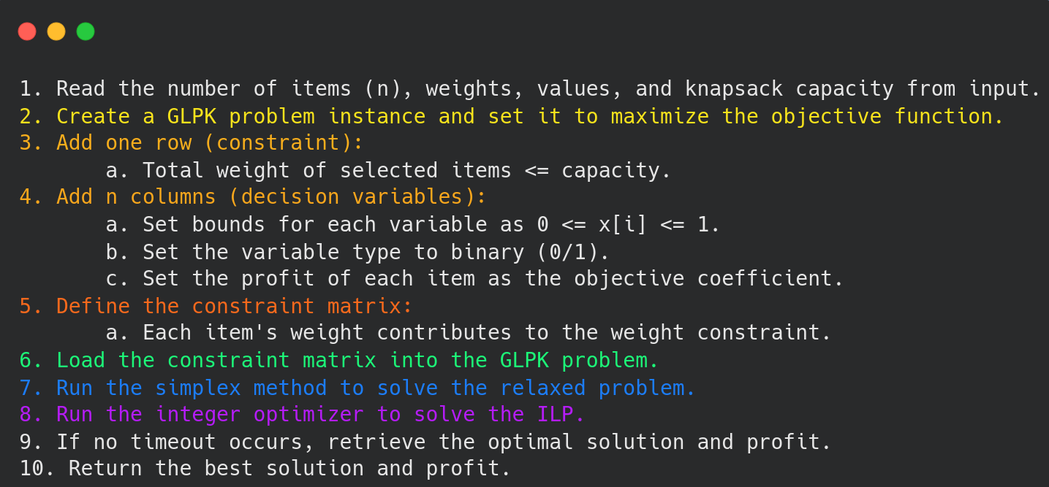
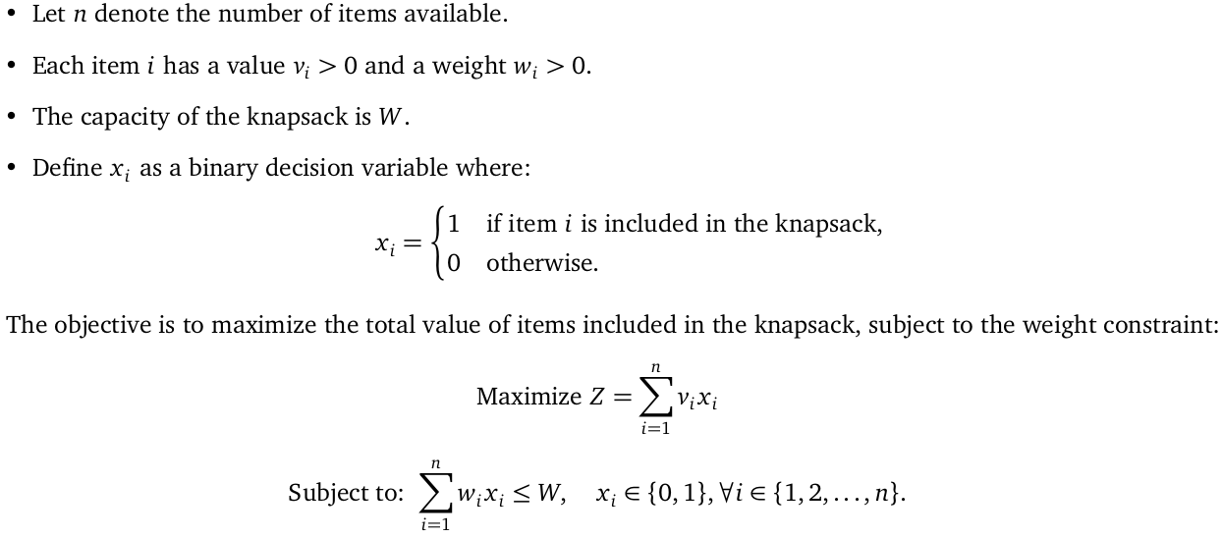
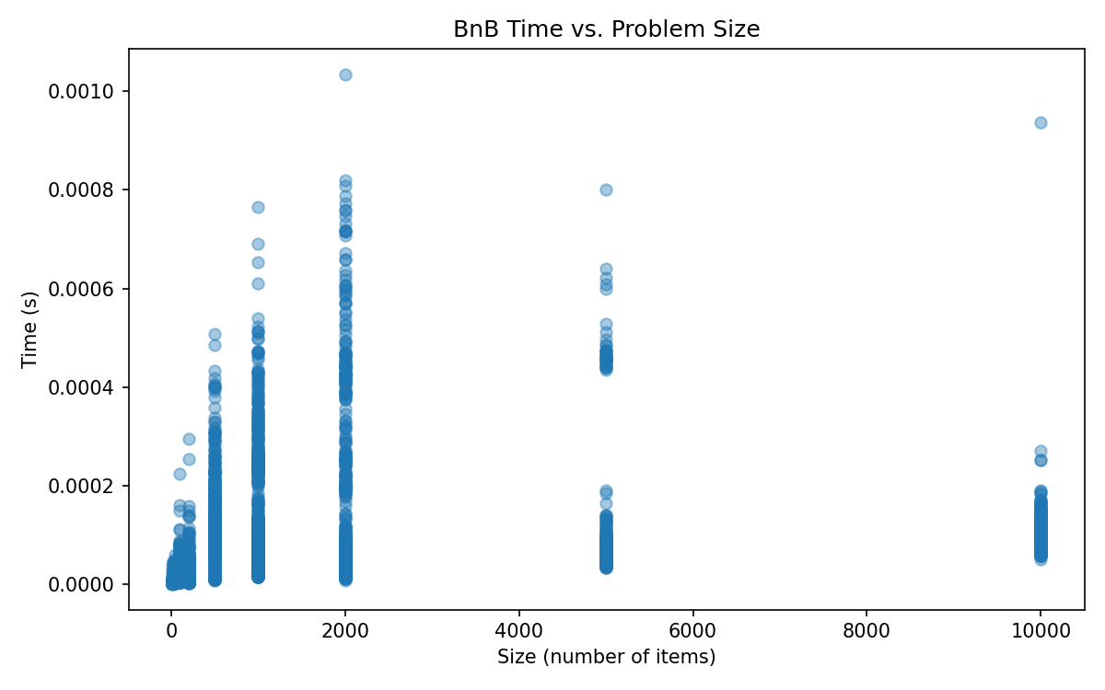
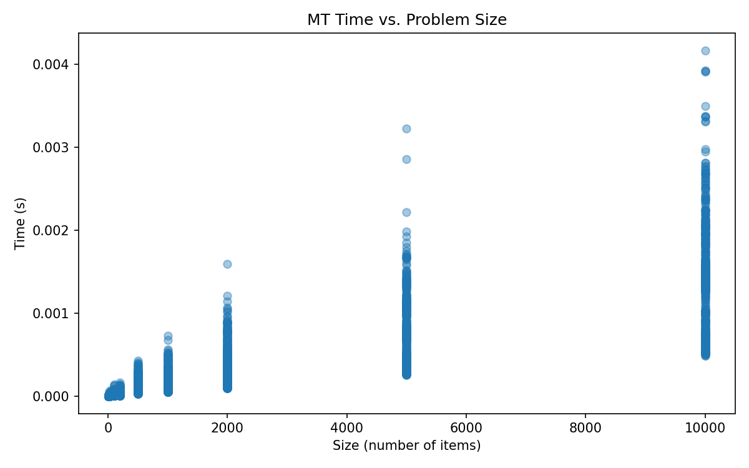
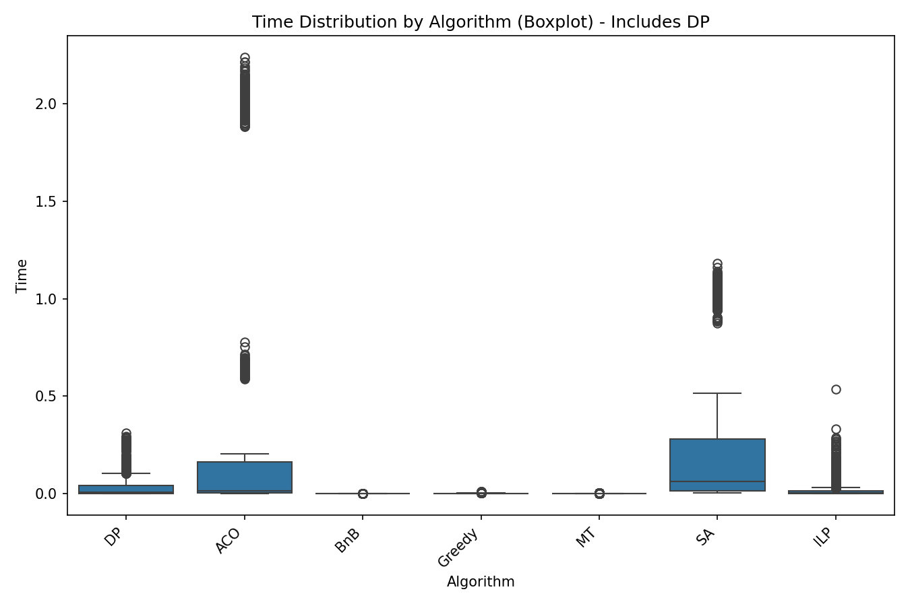
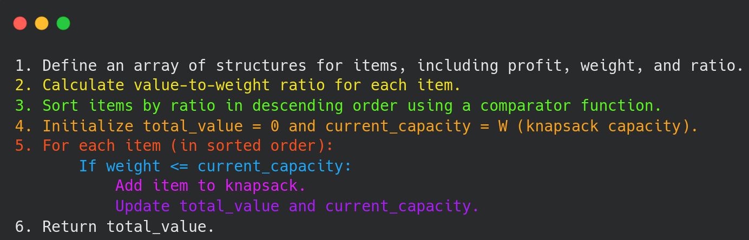
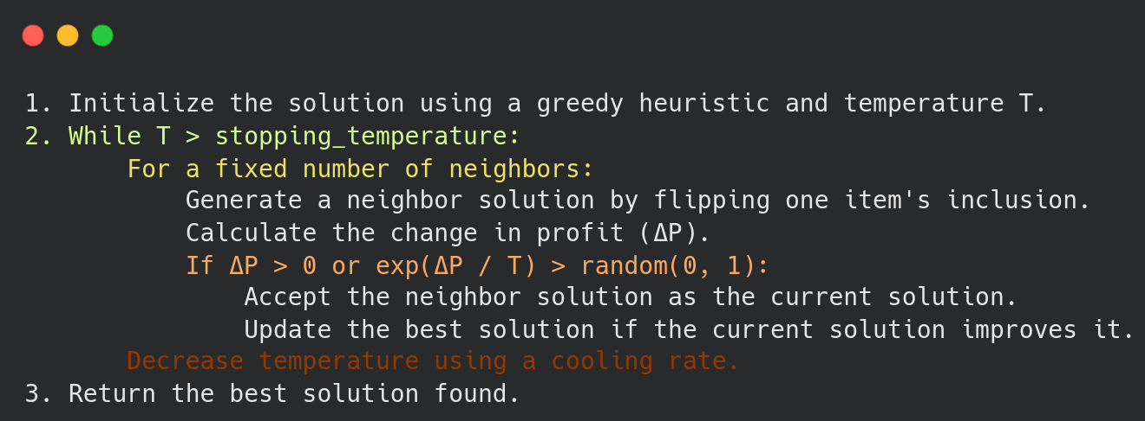
Comparative Analysis of Algorithmic Strategies For the 0/1 Knapsack Problem
Student: Valentino Belotcaci
Advisor: Antonio Carzaniga
Motivation
ILP pseudocode
This study focuses on implementing and comparing various algorithmic approaches to solving the 0/1 Knapsack Problem.
The Knapsack problem has many important applications in various areas in engineering and logistics. However, given the NP-hard nature of the Knapsack Problem, finding efficient and scalable solutions is likely impossible in general. We therefore have to resort to various heuristics, that may be effective for some classes of problems. Comparing these different algorithms provides information of their performance, helping identify the most suitable methods for different scenarios. This is important when dealing with large-scale benchmarks and the need for a statistical evaluation of algorithmic efficiency.
Mathematical formulation
Results
Benchmarks
The study was conducted by generating 5000 benchmarks of different sizes and retrieving other 3000 from a research paper. Each benchmark was ran using dynamic programming, greedy algorithm, branch and bound, Martello-Toth, Simulated Annealing, ACO and Integer Linear Programming. After running each algorithm we registered important information such as memory usage, time taken and best value found. Subsequently we conducted a statistical analysis on each algorithm computing the mean, median, standard deviation, error %,total time or memory… The created benchmarks, were structured in different sizes(from 10 to 10,000) and different capacities(from 10 to 1,000) choosen randomically. Each benchmark line was created following the structure of the research paper’s benchmarks, having for each line the id as first value, weight as second (from 1 to half knapsack’s capacity) and profit as third(from 1 to 100).
Greedy pseudocode
Greedy and dp results, hard benchmarks
Metric | Time results (s) | Memory Results(KB) | Error Results (%)
Total | 0.627559 | 6.18 GB | -
Mean | 0.000211 | 2175.96 | 0.854
Median | 0.000194 | 2176 | 0.0072
Standard Deviation | 0.000101 | 2347 | 2.048
Minimum | 0.000082 | 2048 | 0
Maximum | 0.001026 | 2176 | 11.32
25th Percentile | 0.000146 | - | 0.000018
75th Percentile | 0.000258 | - | 0.2515
Simulated annealing pseudocode
Metric | Time results (s) | Memory Results(KB) | Error Results (%)
Total | 20691 | 3220 GB | -
Mean | 19.176 | 3129328 | 0
Median | 14.756 | 3127936 | 0
Standard Deviation | 15.072 | 1105378 | 0
Minimum | 1.815 | 1564416 | 0
Maximum | 81.999 | 4691200 | 0
25th Percentile | 6.531 | - | 0
75th Percentile | 29.088 | - | 0

